Slide 1
“Carefully Careless”
Proverbs 14:12

Slide 2
C – Choice
E – Exercise
L – Liquid
E – Environment
B – Beliefs
R – Rest
A – Air
T – Transparency
I – Integrity
O – Optimism
N – Nutrition
S – Society Support and Service

Slide 3
Choice and Temperance
CHOICE
Joshua 24:15
And if it seem evil unto you to serve the LORD, choose you this day whom ye will serve;……..
but as for me and my house, we will serve the LORD.

Slide 4
TEMPERANCE
1 Corinthians 10:31
Whether therefore ye eat, or drink, or whatsoever ye do, do all to the glory of God.

Slide 5
Message
Technological advancement
High Crime rates
Two extremes of poverty and wealth
Temptations from every corner surrounded by evil all around

Slide 6
Ephesians 5:15-16
“very careful”
Carefulness requires the power of the holy spirit
Temperance (Self-control) is defined as total avoidance of harmful substances and/or behaviours as well as use of good substances and/or behaviours in moderation. This calls for action in being extra careful in that which is harmful.

Slide 7
Proverbs 25:28
Temperance in;
What we eat ,
Smoking,
Alcohol
Drug abuse
Tobbaco
Soda 🥤

Slide 8
A word of caution to parents
Some parents and guardians are so careful about their individual health and so careless about the health of their youth and children. Careful to raise school fees and clothing but careless about the health of their children.

Slide 9
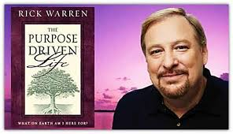
Son of a mega-church Pioneer dies
Rick Warren

Slide 10
Careless about what they watch, which friends they have and choosing Christian schools that will nurture the young people free from drugs and similar vices.

Slide 11
Because we are carefully care - less our young people have fallen prey to substance abuse and some succumbed to its evil effect of addiction, mental illnesses, and suicide.

Slide 12
Statistics
4 out of 10 youth have used a drug of abuse before their 18th birthday including cigarette or pipe smoking, alcohol, marijuana, kuba, mira, cat, and many others.

Slide 13
SOLUTION
The right way is to build strong walls around us and our children and that is SELF-CONTROL

Slide 14
What power can the tobacco devotee have to stay the progress of intemperance? There must be a revolution upon the subject of tobacco before the ax will be laid at the root of the tree.
Tea, coffee, and tobacco, as well as alcoholic drinks, are different degrees in the scale of artificial stimulants. CTBH 34.1

Slide 15
The effect of tea and coffee, as heretofore shown, tends in the same direction as that of wine and cider, liquor and tobacco.

Slide 16
Tea is a stimulant, and to a certain extent produces intoxication. It gradually impairs the energy of body and mind. Its first effect is exhilarating, because it quickens the motions of the living machinery; and the tea-drinker thinks that it is doing him great service. But this is a mistake. When its influence is gone, the unnatural force abates, and the result is languor and debility corresponding to the artificial vivacity imparted. The second effect of tea drinking is headache, wakefulness, palpitation of the heart, indigestion, trembling, and many other evils.

Slide 17
Coffee is a hurtful indulgence. It temporarily excites the mind to unwonted action, but the after-effect is exhaustion, prostration, paralysis of the mental, moral, and physical powers.
The mind becomes enervated, and unless through determined effort the habit is overcome, the activity of the brain is permanently lessened.

Slide 18
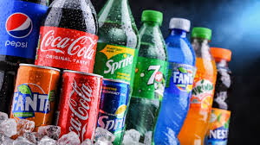
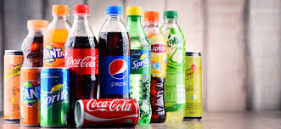

Slide 19
All these nerve irritants are wearing away the life-forces, and the restlessness caused by shattered nerves, the impatience, the mental feebleness, become a warring element, antagonizing to spiritual progress.

Slide 20
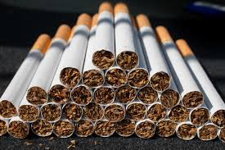
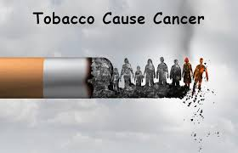

Slide 21
Then should not those who advocate temperance and reform be awake to counteract the evils of these injurious drinks? In some cases it is as difficult to break up the tea-and-coffee habit as it is for the inebriate to discontinue the use of liquor. The money expended for tea and coffee is worse than wasted.

Slide 22
Since a healthy state of mind depends upon the normal condition of the vital forces, what care should be exercised that neither stimulants nor narcotics be used! Yet we see that a large number of those who profess to be Christians are using tobacco. They deplore the evils of intemperance; yet while speaking against the use of liquors, these very men will eject the juice of tobacco.

Slide 23
Intemperance
Intemperance in eating and in drinking, and the indulgence of base passions, have benumbed the fine sensibilities, so that sacred things have been placed upon a level with common things.—Spiritual Gifts 4a:124, 1864

Slide 24
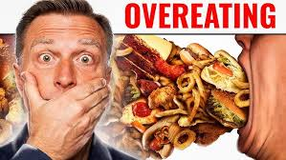

Slide 25
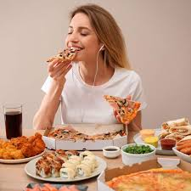
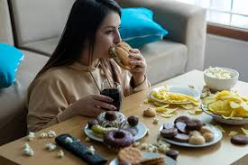
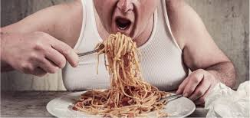
OVER EATING

Slide 26
Irregularity in eating and drinking, and improper dressing, deprave the mind and corrupt the heart, and bring the noble attributes of the soul in slavery to the animal passions.—The Health Reformer, October, 1871

Slide 27
Is over eating a sin?
The course of Brother H has not been what it should have been. His likes and dislikes are very strong and he has not kept his own feelings under the control of reason. Brother H, your health is greatly injured by over-eating, and eating at improper times. This causes a determination of blood to the brain. The mind becomes confused, and you have not the proper control of yourself.

